Slide 1
ML Models for Diabetes Screening
Reporter: Zhang Yibo
MCS241044
Instructors：Shahizan

Slide 2
Catalog
01
Presentation Overview
02
Research Background
03
Research Objectives
04
Methodology and Results

Slide 3
Presentation Overview
01

Slide 4
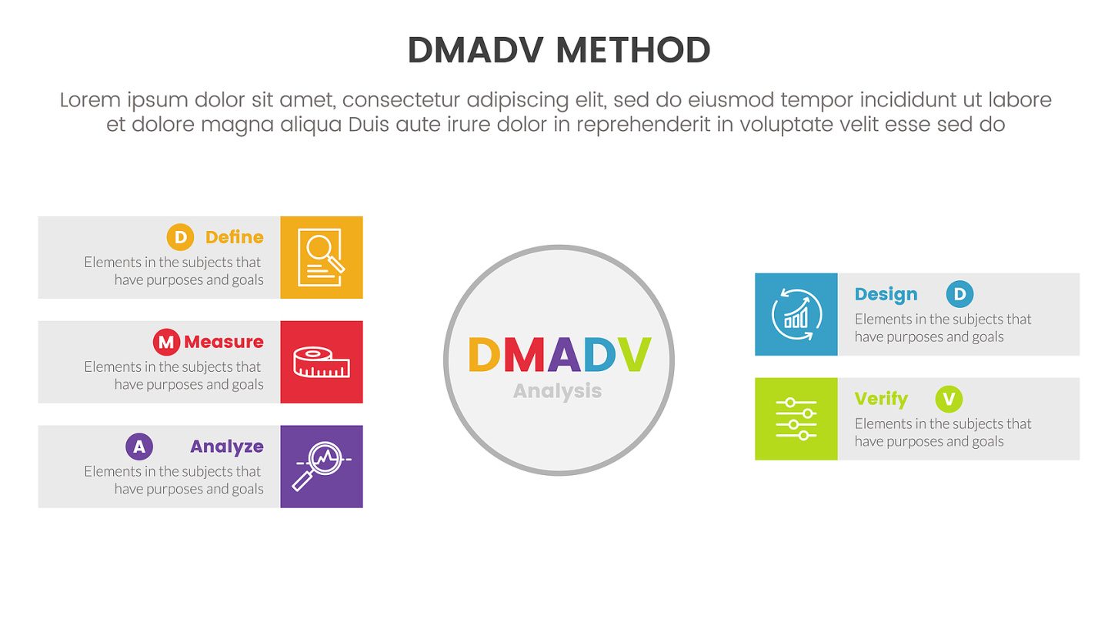

Introduction to Diabetes Screening
Research Objectives
Overview of the importance and potential of ML models in early diabetes detection
Evaluating ML models, testing in low-resource settings, and recommending solutions

Slide 5

01
Methodology and Findings
Review of literature, dataset, methodology workflow, and comparison of ML models' performance
02
Conclusion and Contributions
Summarizing the framework's effectiveness and its contributions to the field

Slide 6
Research Background
02

Slide 7
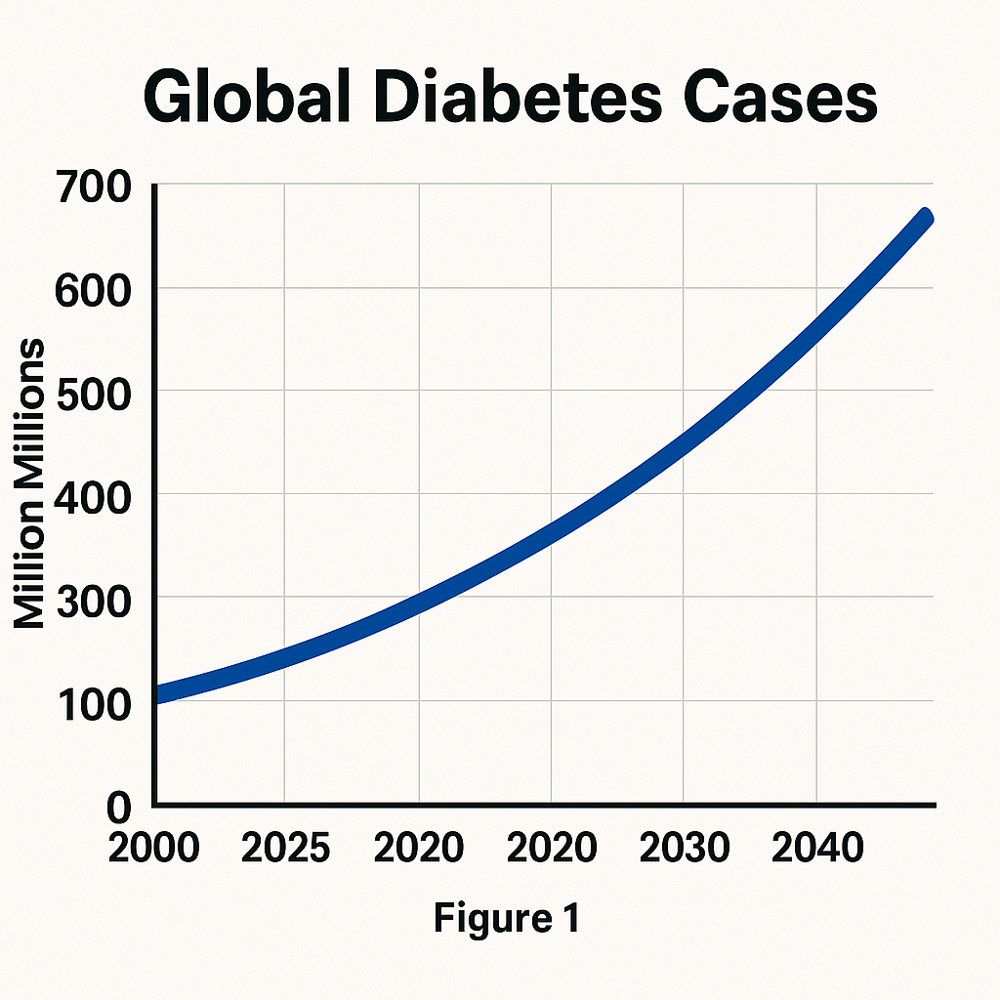

Global Diabetes Trend
Increasing Diabetes Prevalence
Public Health Concern
Figure 1 shows the upward trend of global diabetes cases.
The trend indicates a growing burden on healthcare systems.

Slide 8
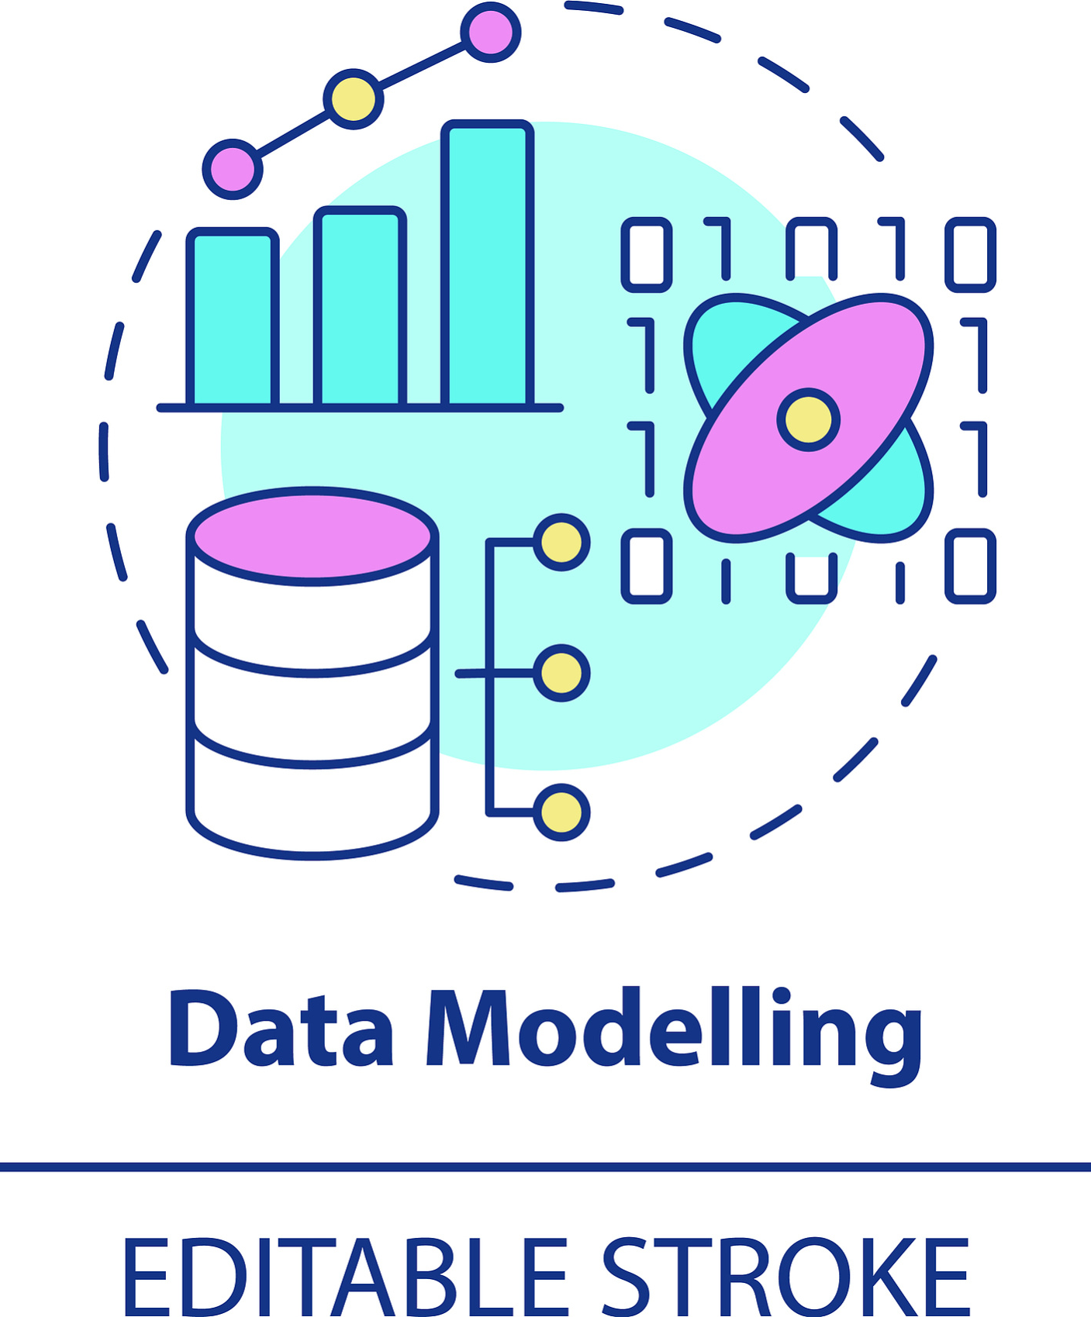
Research Problem
01
Early Screening Necessity
Identifying the best ML model for early detection of diabetes.
02
Resource-Constrained Settings
Focusing on ML models suitable for low-resource clinical environments.

Slide 9
Research Objectives
03

Slide 10
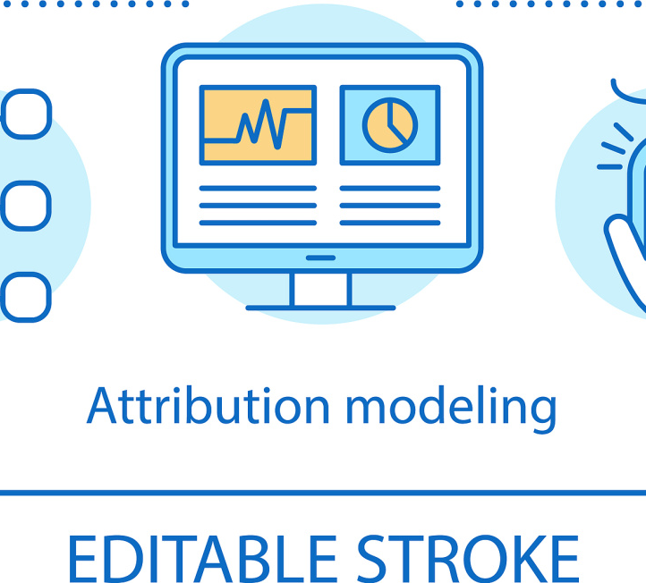

Evaluation of ML Models
Evaluate 6 ML models
Consistency in model training
The research aims to assess the performance of six traditional machine learning models for diabetes screening.
All models are trained using the same Pima dataset to ensure a fair comparison.

Slide 11

Testing Environment
Low-resource clinical settings
Performance under missing data
The models will be tested in resource-constrained clinical environments to evaluate their practicality.
The robustness of the models will be tested against varying levels of missing data.

Slide 12
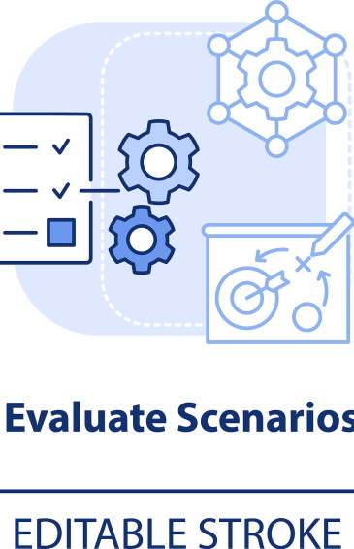

Solution Recommendation
01
02
Context-based solutions
Logistic Regression for low-resource
The study recommends specific ML models tailored to the constraints of different clinical settings.
Logistic Regression is recommended for use in low-resource clinics due to its computational efficiency and interpretability.

Slide 13

Solution Recommendation
Random Forest for resource-rich
Random Forest is suggested if resources permit, due to its higher accuracy and predictive power.

Slide 14
Methodology and Results
04

Slide 15

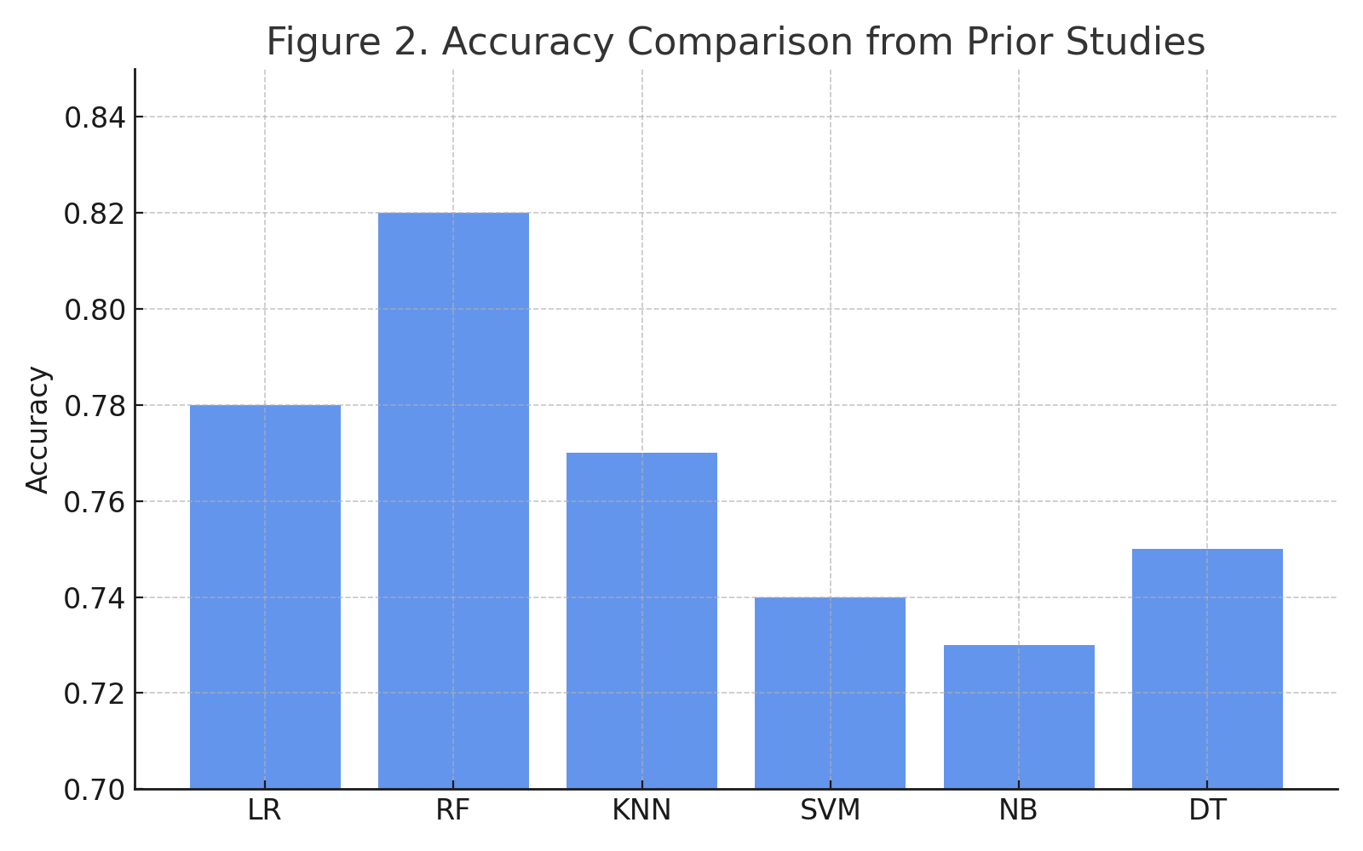
Literature Review
02
Model Performance Trends
01
Prior Studies Accuracy
Random Forest consistently shows higher accuracy in prior studies.

Slide 16
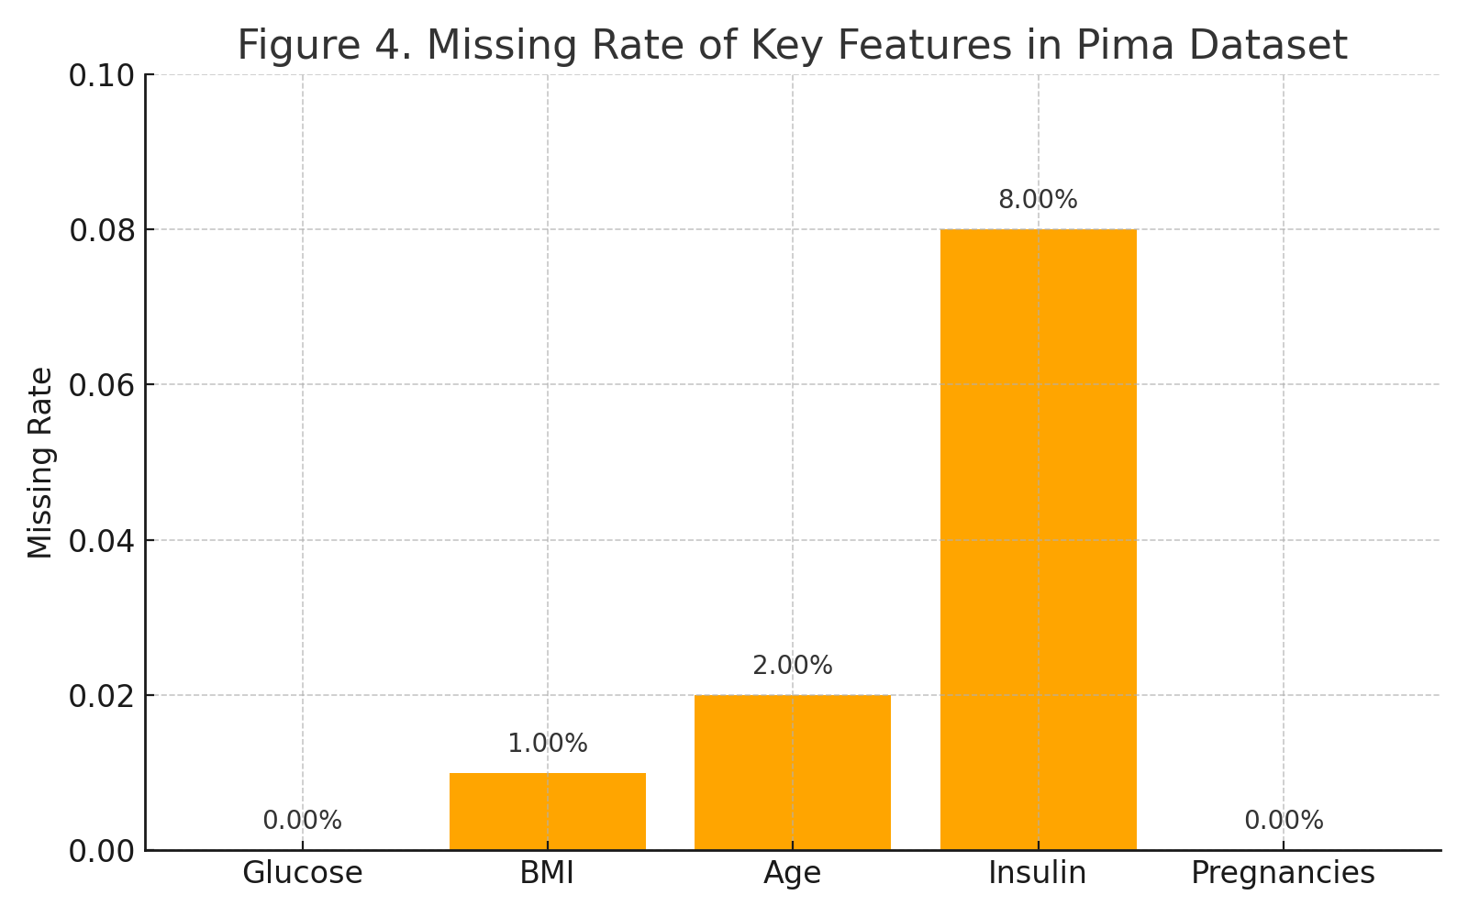


Dataset Overview
Feature Missing Rates
Only insulin shows notable missing values (~8%).
Data Set Characteristics

Slide 17


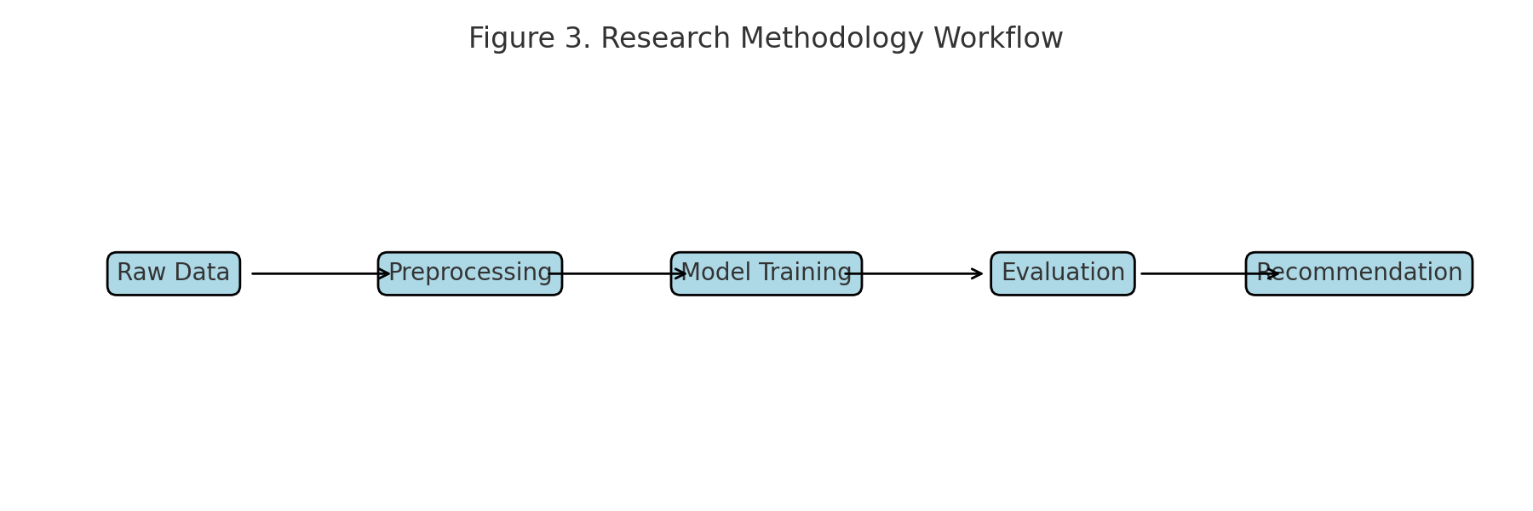
Methodology Workflow
Stepwise Pipeline Approach
Workflow Visualization
Stepwise pipeline: preprocessing → model training → evaluation.

Slide 18

Models Compared
01
ML Models Evaluated
Logistic Regression, Decision Tree, KNN, Naive Bayes, SVM, Random Forest.
02
Training Consistency
All models are trained using the same Pima dataset for consistency.

Slide 19
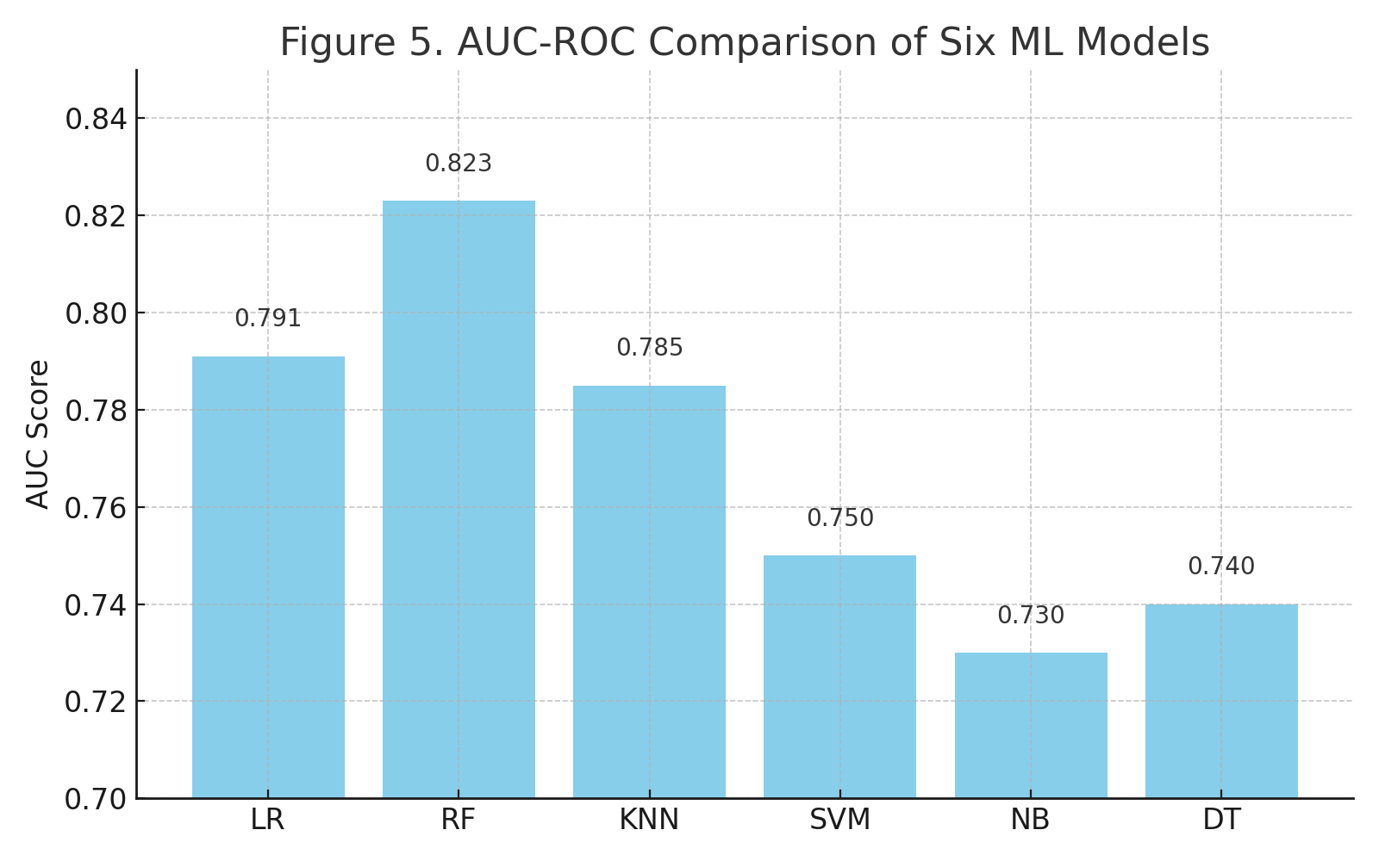


Performance Comparison
Random Forest achieves the highest AUC (0.823).
Highest AUC Achieved
Performance Visualization

Slide 20
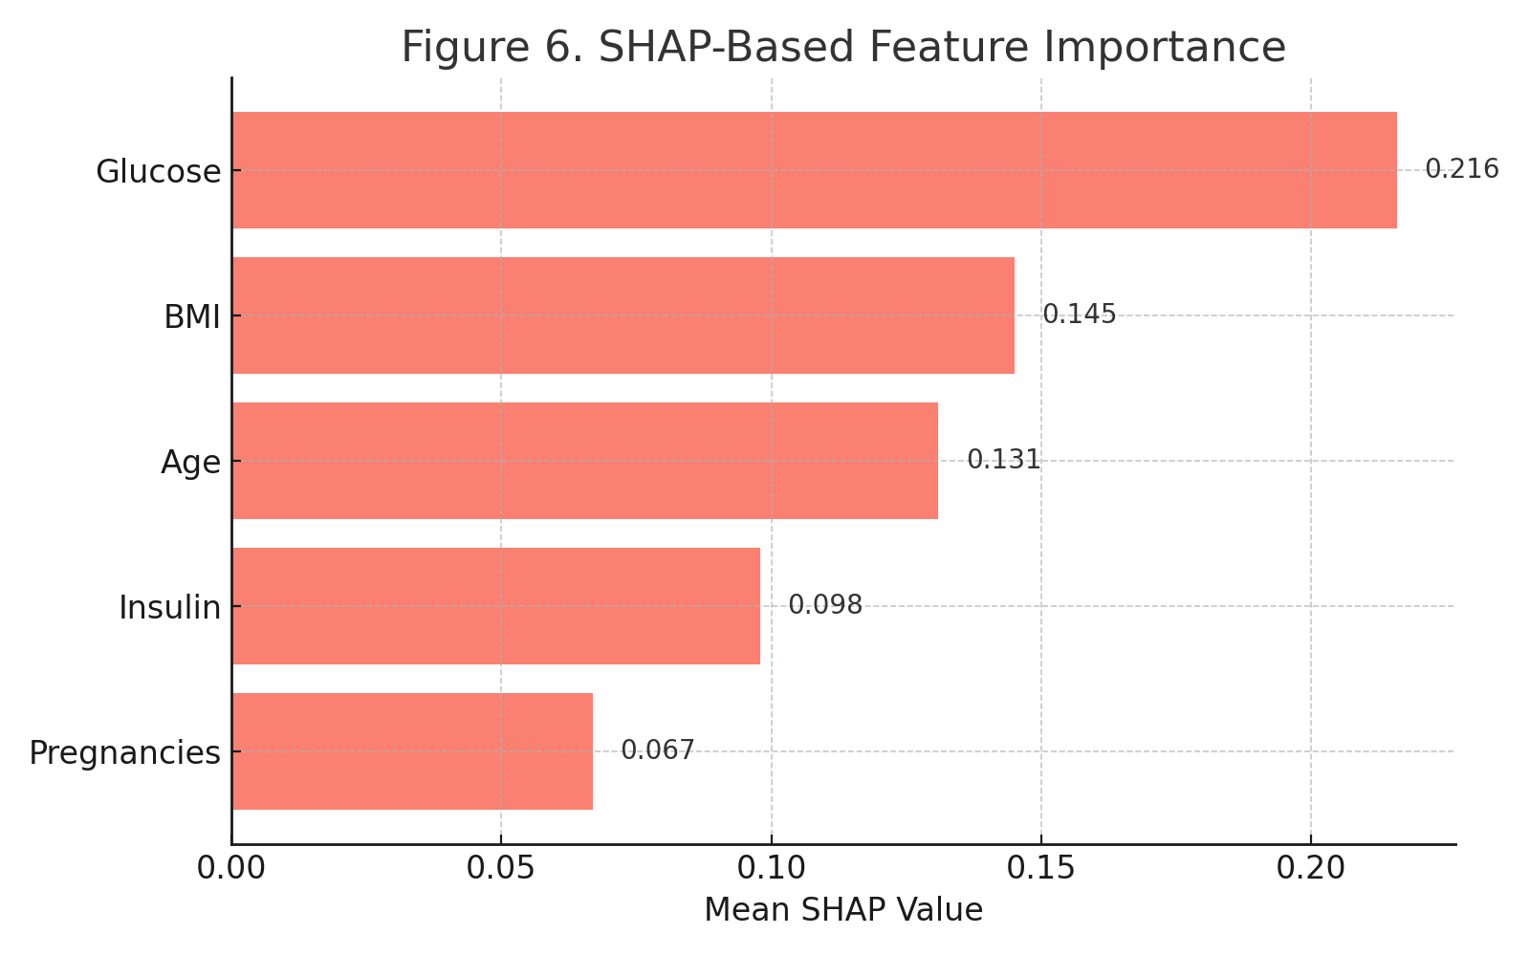
Feature Importance
01
SHAP Value Analysis
Glucose has the highest SHAP value, indicating strong predictive power.
02
Feature Impact Ranking
单击此处输入你的正文，文字是您思想的提炼，为了最终演示发布的良好效果，请言简的阐述观点。

Slide 21
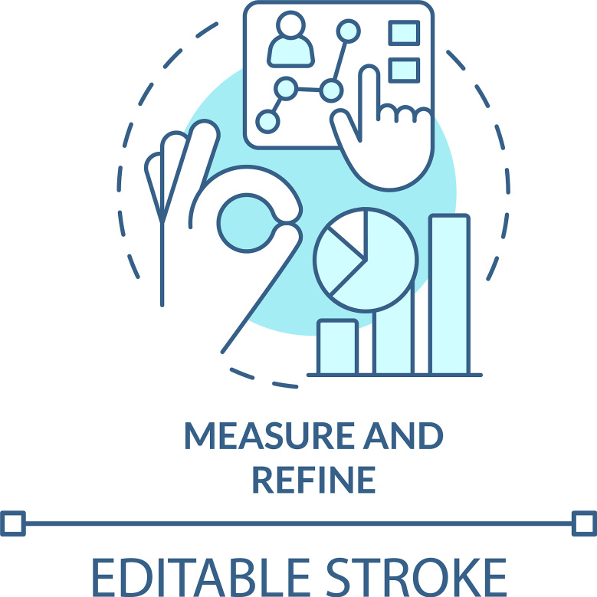
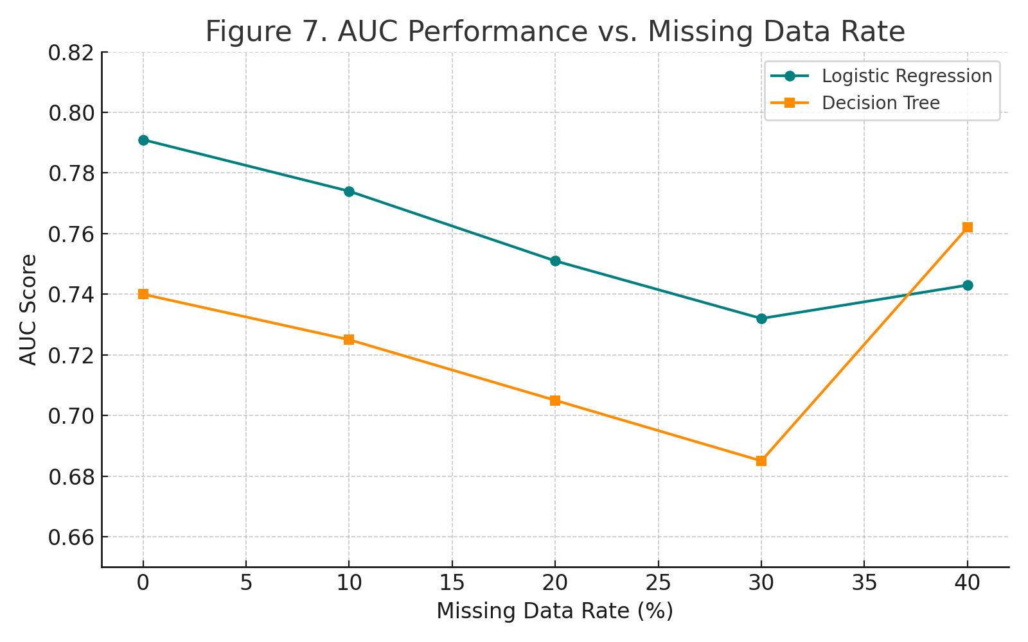
Missing Data Robustness
LR vs DT Stability
LR is more stable across missing data levels than DT.
Robustness Evaluation

Slide 22
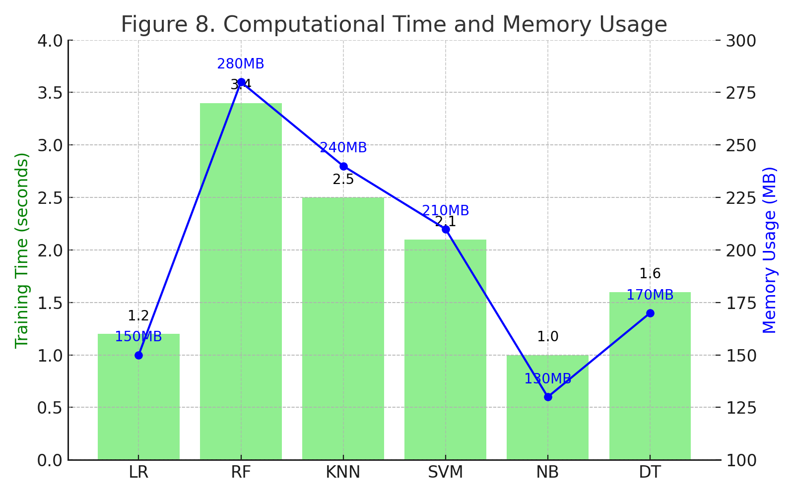
Computational Efficiency
01
Naive Bayes Speed
Naive Bayes is the fastest; RF uses the most memory.
02
Resource Usage Comparison

Slide 23

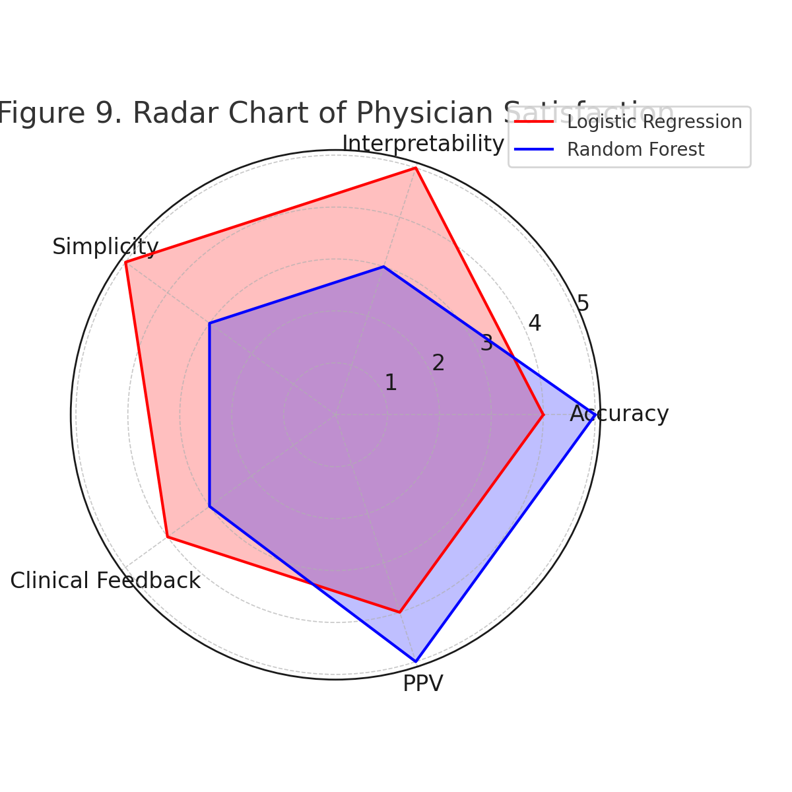
Clinical Validation
Interpretability and Simplicity
LR scores highest in interpretability and simplicity.
Clinical Validation Results

Slide 24
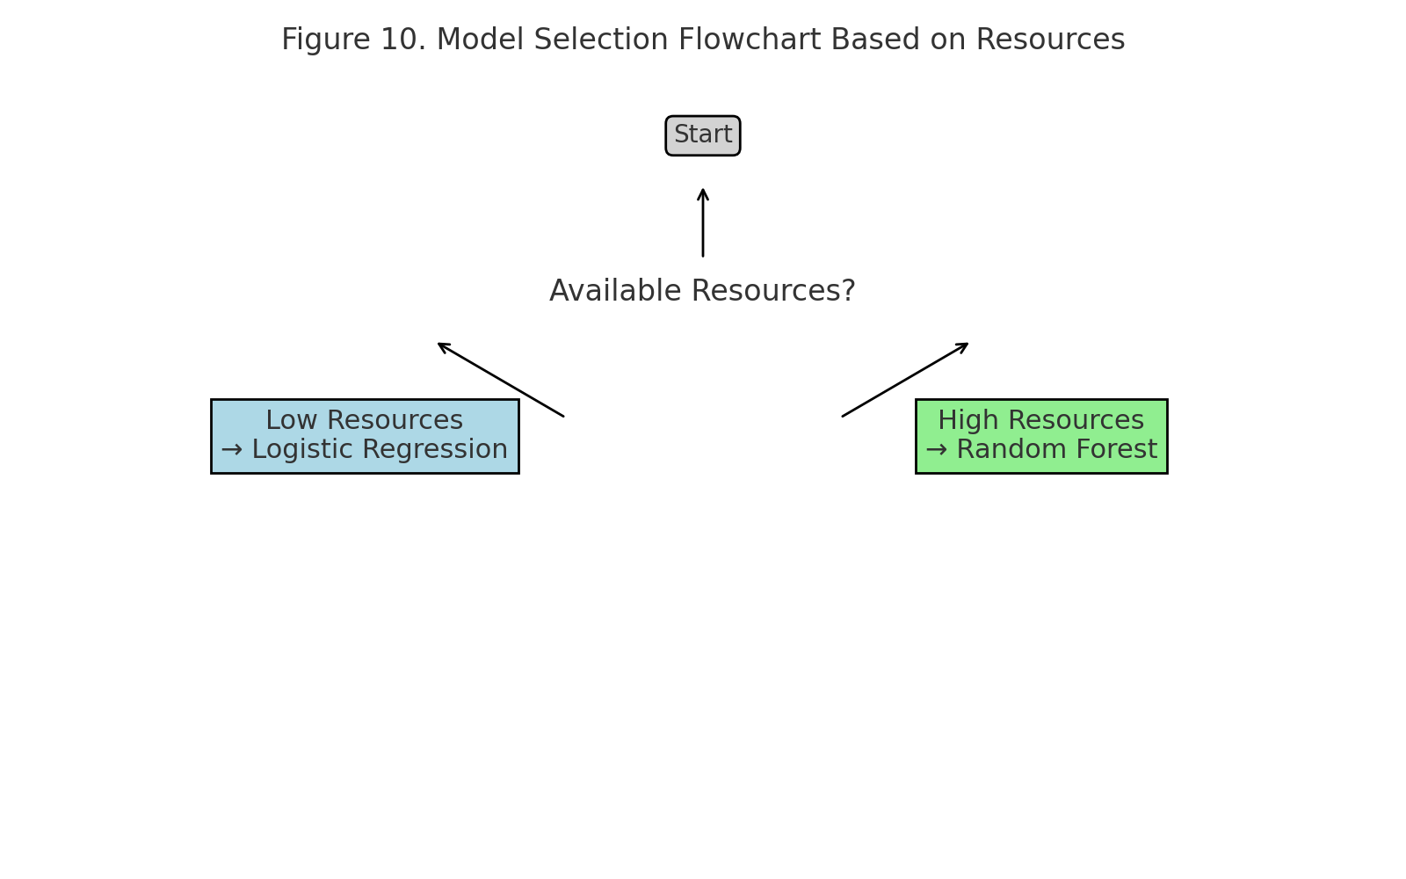
Model Recommendation
Low-Resource Clinic Model
Use Logistic Regression in low-resource clinics.
Resourceful Setting Model
Use Random Forest if resources permit.
Recommendation Flowchart

Slide 25
Video link
https://youtu.be/qGbj8_p9ICo

Slide 26
Thanks
Reporter: Zhang Yibo
MCS241044

